Slide 1
Insurance Policies
Saswat Mishra | Bhubaneswar| 20th Feb. 2018
Notes:
A cor AZUL sempre tem que aparecer no slide. Seja nas formas ou no texto.
Uma imagem como essa nao funciona. Muito “Barbie” para uma consultoria. Eles gostam deste layout mas deveria estar separador de capitulos com o logo de “espadas” maior. Para toda insercao de imagem o fundo deve ser cinza claro.

Slide 2

Elements of A Contract
Agreement (Offer & Acceptance)
Capacity to Contract
Consideration
Legal Purpose

Slide 3
Characteristics of Insurance Policies
Contract of Indemnity
Contract of Utmost Good Faith
Contract Involving Fortuitous Events & Exchange of Unequal Amount
Contract of Adhesion
Conditional Contract
Nontransferable Contract

Slide 4
Insurance Policy Structure
Preprinted Form:- An Insurance form that meets the needs of many policyholders & is therefore printed in bulk for future use.
Manuscript Form:- An Insurance form that is drafted according to terms negotiated between a specific insured and an insurer
Self Contained Policies:- A single document policy
Modular Policies:- A combination of documents to include all the agreements between insured and insurer

Slide 5
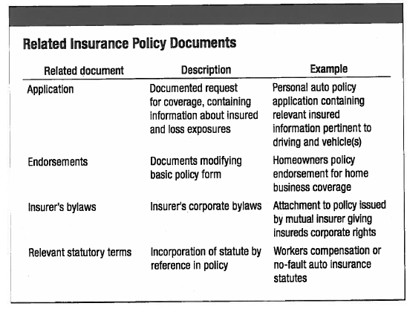

Slide 6
Policy Provisions
CATEGORY | DESCRIPTION
Declarations | Unique information on the insured, list of forms included in policy
Definitions | Words with special meanings in policy
Insuring Agreements | Statements containing insurer’s promise to make payment
Conditions | Qualifications on promise to make payment
Exclusions | Provisions stating what the insurer will not cover
Miscellaneous Provisions | Wide variety of provisions that may alter policy
Notes:
Usar nos grafico o AZUL como cor principal. (no lugar do verde aqui). Tambem incluir uma variacao de cores mais coorporate, baseado em azuis, para os resultados financeiros. O numero da pagina deve estar abaixo lado direiro, mudar o espada de lugar.

Slide 7
PROPERTY POLICY PROVISIONS | LIABILITY POLICY PROVISIONS
Covered Property | Covered Activities
Covered Locations | Covered Types of Injury – Bodily Injury / Property Damage / Personal Injury
Covered Causes of Loss – Named Peril/Special or Open Perils | Excluded Loss Exposures
Excluded Causes of Loss | Covered Costs – Damages / Defense Cost / Supplementary Payment (Pre & Post Judgment Interest) / Medical Payments
Covered Financial Consequences | Covered Time Period – Occurrence Basis Coverage / Claims-made Coverage
Amount of Recovery – Policy Limits / Valuation Provisions / Settlement Options / Deductible / Insurance-to-value Provisions / Other Insurance Provisions | Covered Parties
---------- | Amount of Recovery – Policy Limits (Each Person Limit, Each Occurrence Limit, Split Limit, Single Limit) / Defense Cost Provisions / Other Insurance Provisions
Notes:
Usar nos grafico o AZUL como cor principal. (no lugar do verde aqui). Tambem incluir uma variacao de cores mais coorporate, baseado em azuis, para os resultados financeiros. O numero da pagina deve estar abaixo lado direiro, mudar o espada de lugar.

Slide 8
Each person limit: The maximum amount an insurer will pay for injury to any one person for a covered loss.
Aggregate limit: The maximum amount an insurer will pay for all covered losses during the covered policy period.
Each occurrence limit: The maximum amount an insurer will pay for all
covered losses from a single occurrence, regardless of the number of persons injured or the number of parties claiming property damage.
Split limits: Separate limits for bodily injury and property damage liability coverage.
Single limit: A single limit of liability for the combined total of bodily injury and property damage from any one accident or occurrence.

Slide 9

Thank You ☺
Notes:
O Logo de espadas deve ter mais espaço das pontas abaixo. Sugerir outros tipos de imagens/ telefone, fones.

